Slide 1


Slide 2
Convolutional Neural Network for Concrete Crack Segmentation
CEE 498 Final Project
04/27/2023
Chengyou Yue and Sharbel Nashar

Slide 3
Outline
Introduction
U-Net architecture
Crack Segmentation using U-Net architecture
Crack Segmentation using Inception U-Net architecture
Civil and Environmental Engineering

Slide 4
Introduction
Cracks in concrete have the potential to create catastrophic failures.
Convolution Neural Networks (CNN) have proven to have a good performance in this application.
Several different models have been developed over the years dealing with object detection and image classification and segmentation.
U-net is an architecture designed for image segmentation that has a good performance. This architecture will be the focus of this report.
Civil and Environmental Engineering

Slide 5
U-Net architecture
Civil and Environmental Engineering

Slide 6
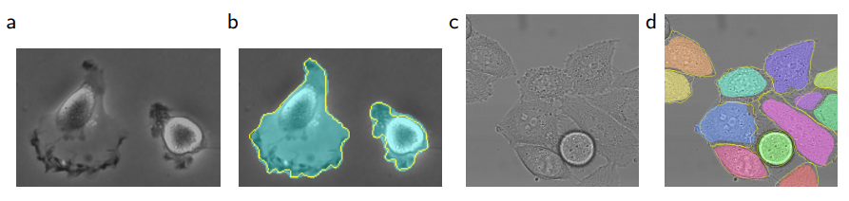
Introduction of U-Net
U-Net is built upon the so-called 'Fully Convolutional Network', it was first introduced in 2015 by Olaf Ronneberger, Philipp Fischer, and Thomas Brox.
It won the ISBI bioimage segmentation challenge 2015.
Figure 1.1. Result on the ISBI cell tracking challenge [1]
Civil and Environmental Engineering

Slide 7
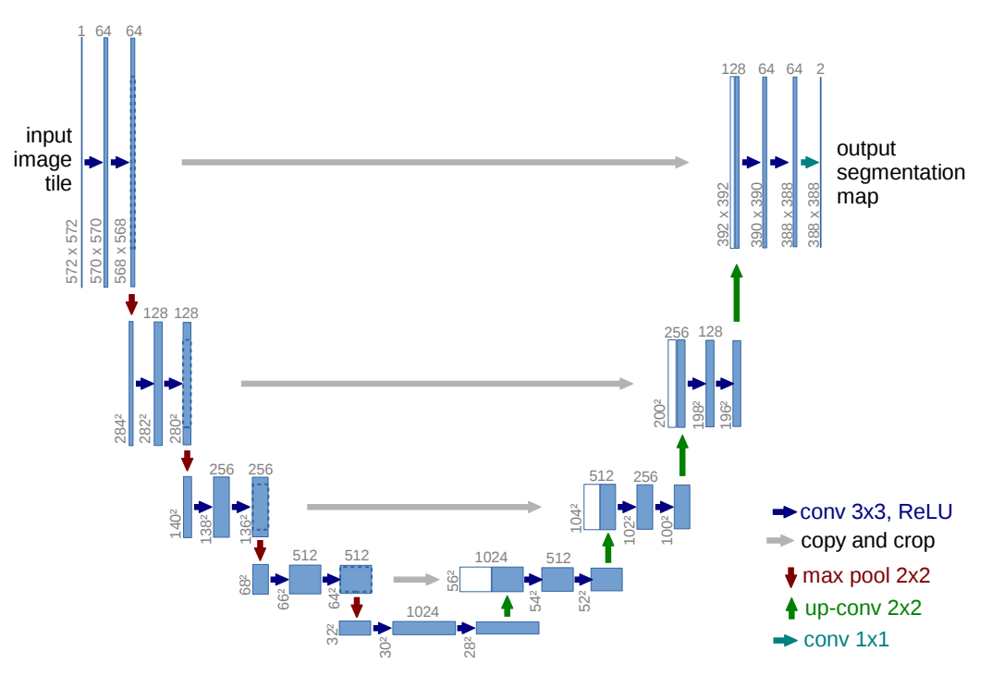
Figure 1.2. U-net architecture [1]
Civil and Environmental Engineering

Slide 8
Crack Segmentation with U-Net
Civil and Environmental Engineering

Slide 9
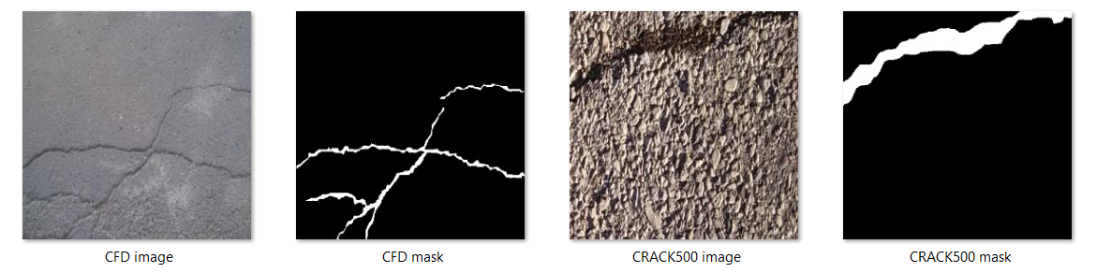
Dataset Description
This dataset is provided by Eric Bianchi and Matthew Hebdon [2]
It contains images (448×448 pixels x 3 RGB channels) and the respective mask image.
This dataset contains many subsets, here we shall use ‘CFD’ and ‘CRACK500’ as our dataset.
Segmentation refers to generating a “mask” from the figure that traces the crack path, as can be seen in the figures.
Figure 2.1. Sample image/mask from CFD and CRACK500 [2]
Civil and Environmental Engineering

Slide 10
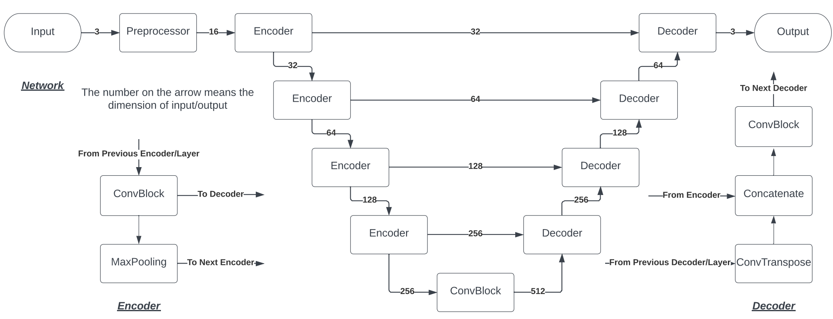
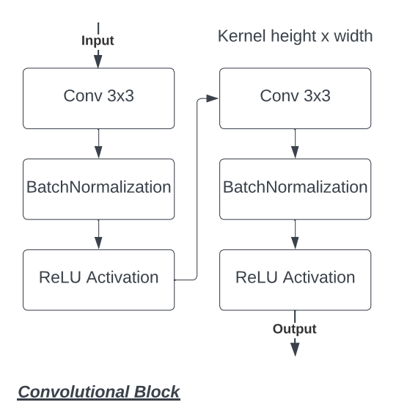
Network Design
In 2019, Zhengqing Liu etc. had applied U-net for concrete crack detection [3].
The key feature of their network is adding BatchNormalization Layer between each Convolutional Layer and Activation Layer.
Figure 2.2. Network design
Civil and Environmental Engineering

Slide 11
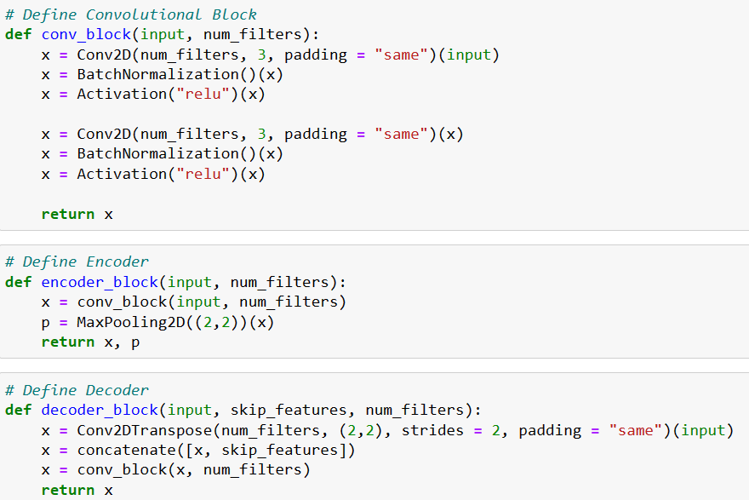
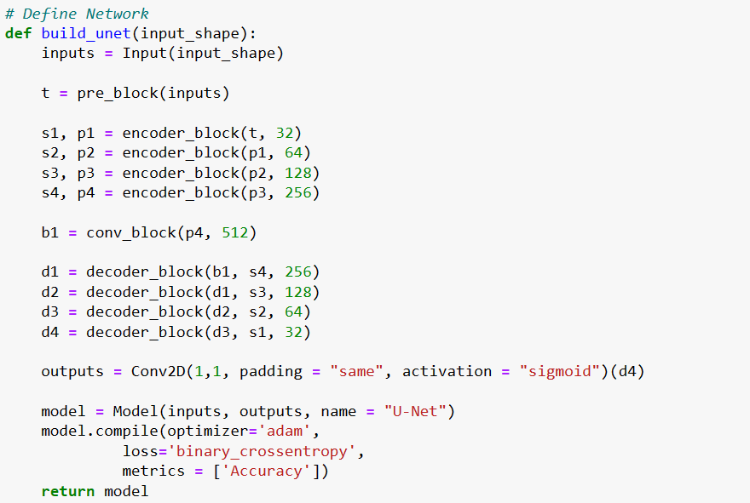
Implementation with Keras
Figure 2.3. Coding with TensorFlow.Keras
Civil and Environmental Engineering

Slide 12
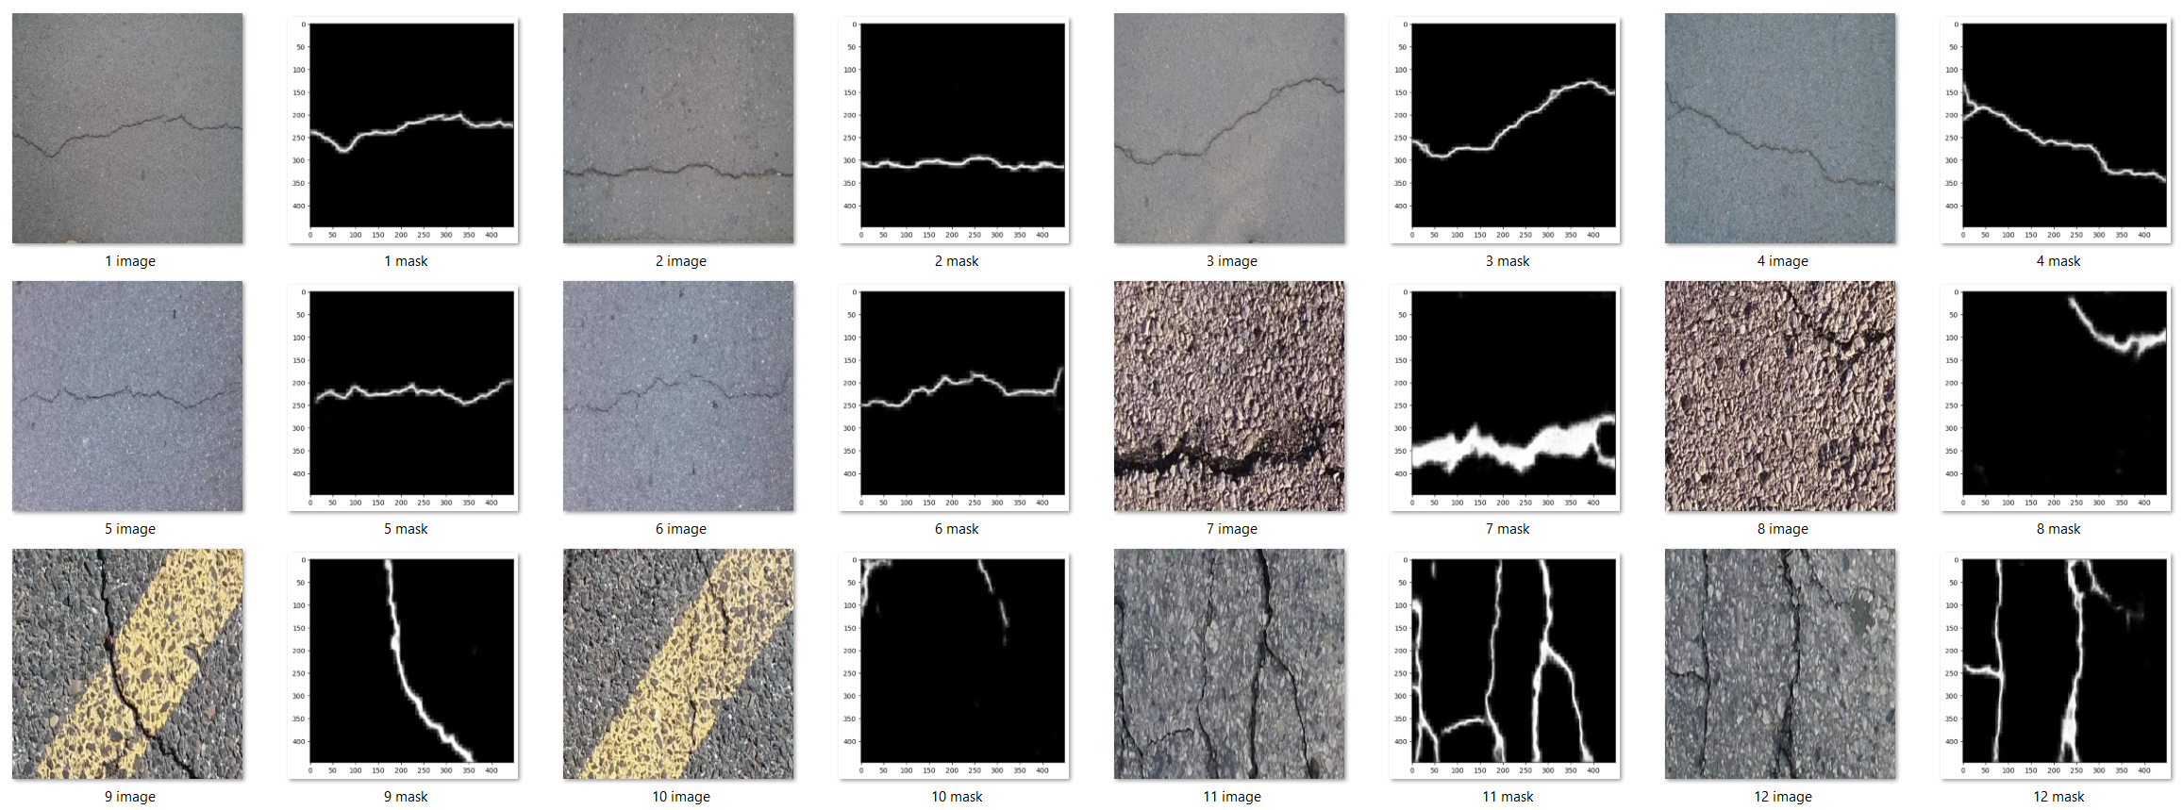
Results
Figure 2.4. Prediction from U-net
Civil and Environmental Engineering

Slide 13
Is it possible to train it on only one subset and segment the other?
Civil and Environmental Engineering

Slide 14
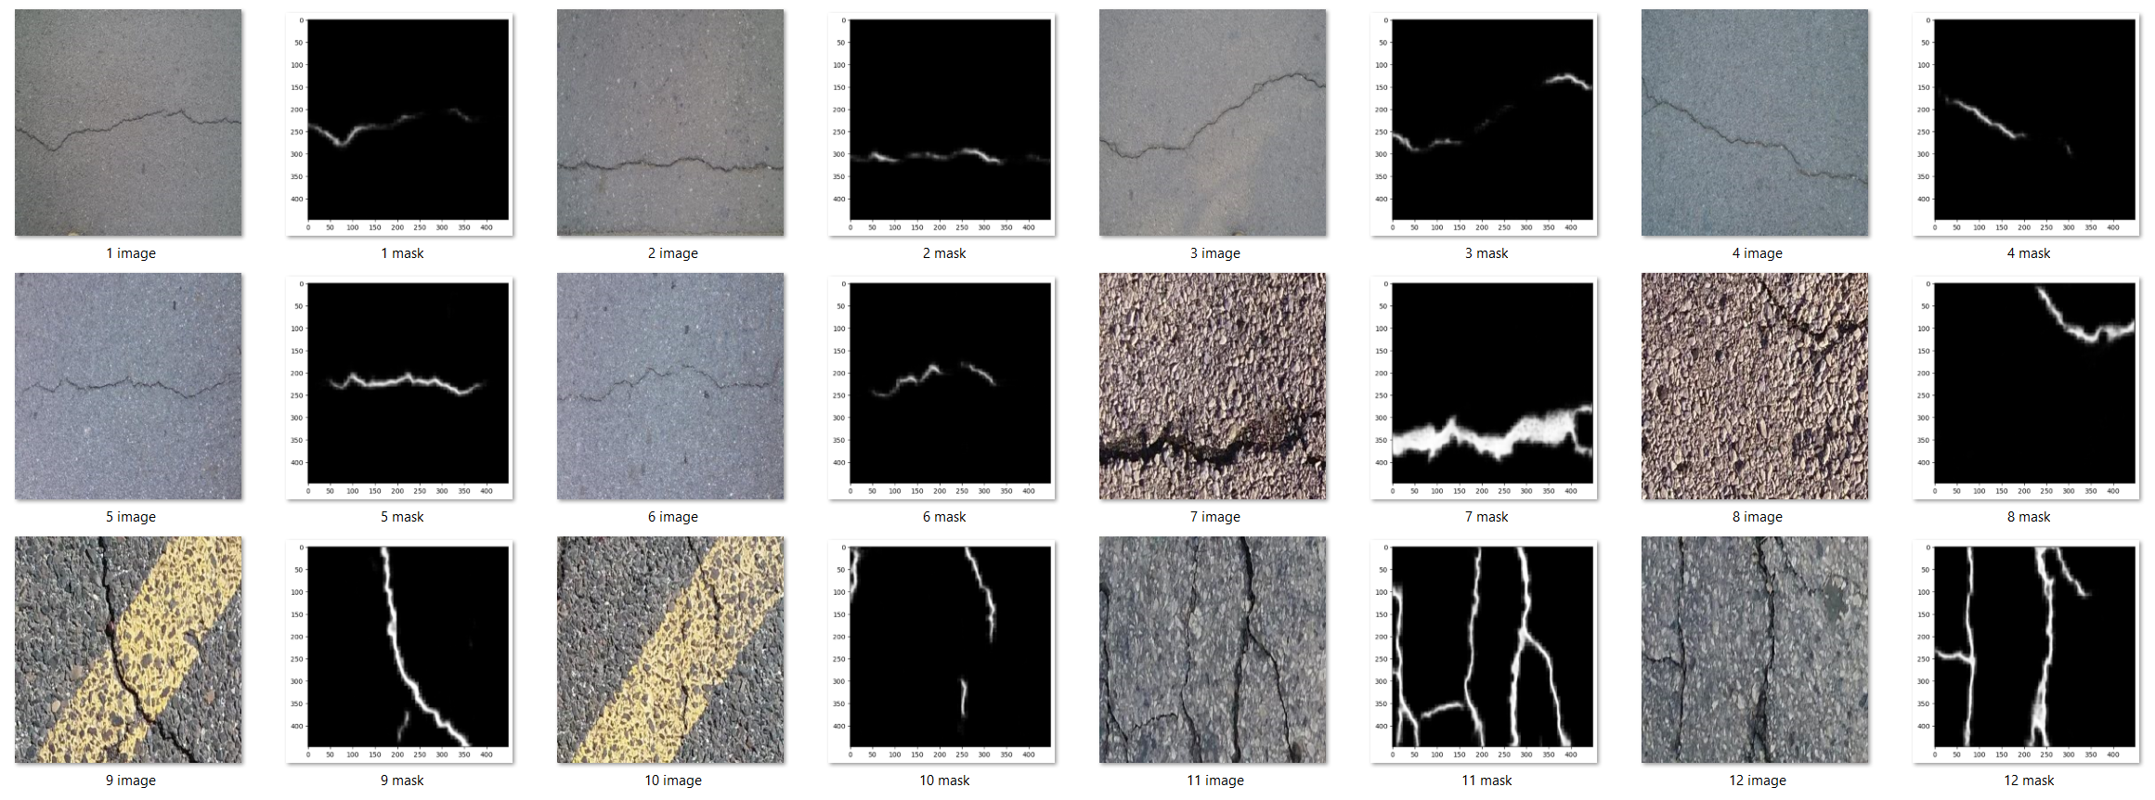
Trained with CRACK500
Figure 3.1. Result with CRACK500 dataset
Civil and Environmental Engineering

Slide 15
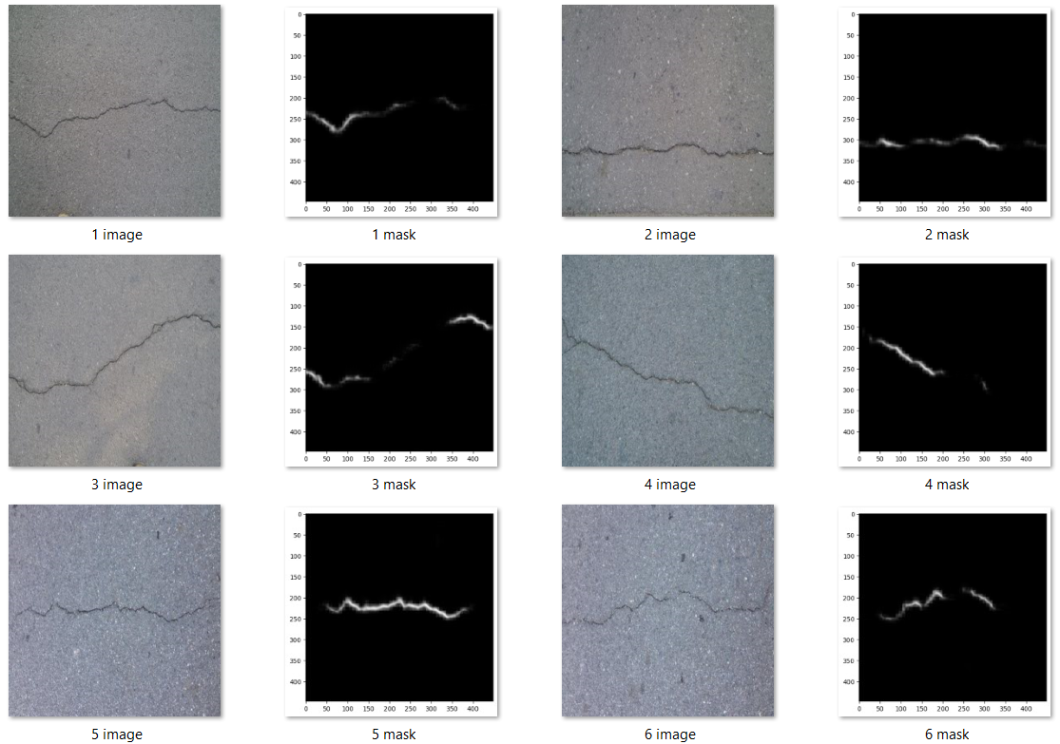
Highlight
Figure 3.2. Highlighting the issue
Civil and Environmental Engineering

Slide 16
Crack Segmentation with Inception U-Net
Civil and Environmental Engineering

Slide 17
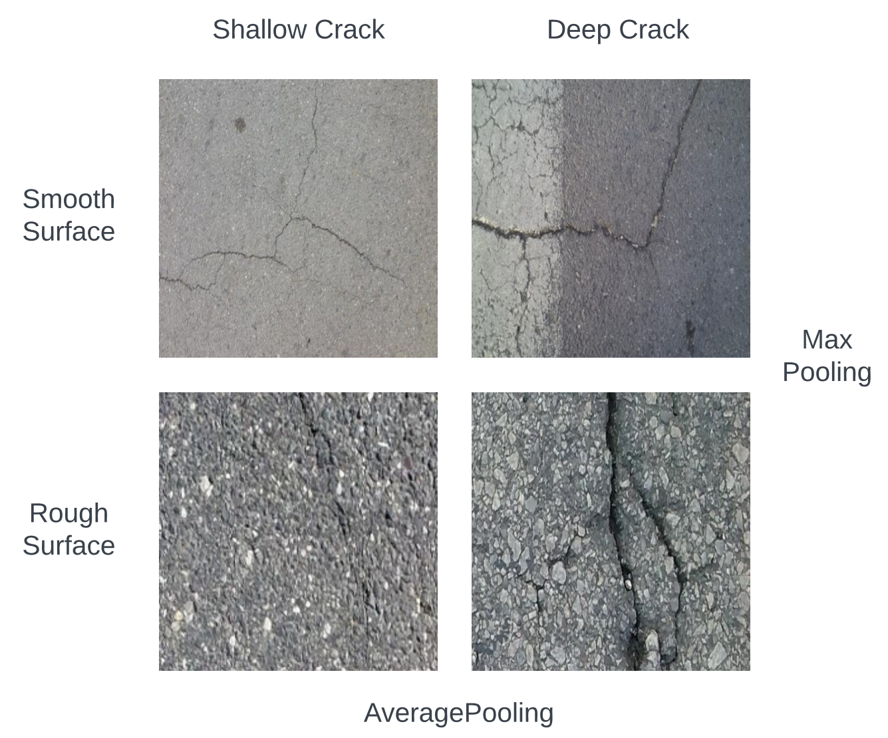
Introduction of Problem Type
A network that is trained on CRACK500 but can still detect shallow cracks
To achieve this, we need to extract more patterns from each encoder, in the other word, we need exploration! (Max Pooling is always greedy)
The encoder can be replaced by networks from classification [5], as classification task will always need exploration.
Figure 4.1. Characteristics of crack & surface
Civil and Environmental Engineering

Slide 18
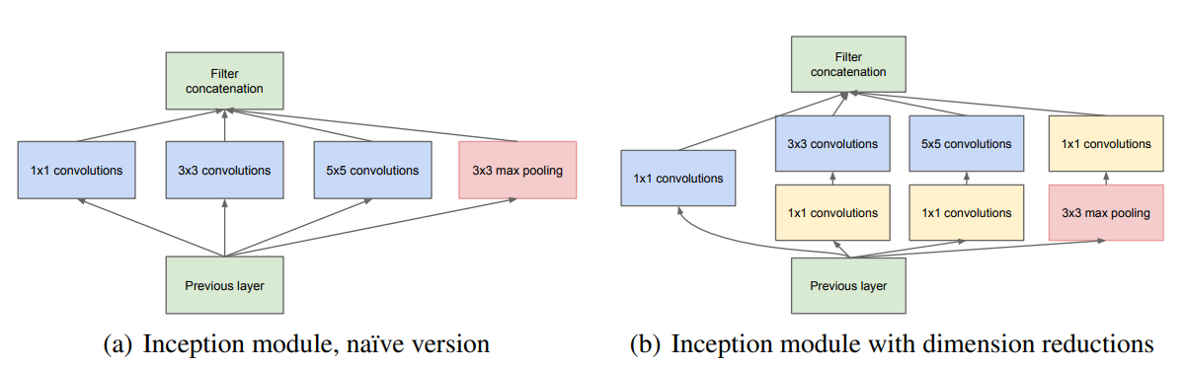
Introduction of Inception Network
The main idea of the Inception architecture is based on finding out how an optimal local sparse structure in a convolutional vision network can be approximated and covered by readily available dense components. [4]
Figure 4.2. Inception Architecture [4]
Civil and Environmental Engineering

Slide 19
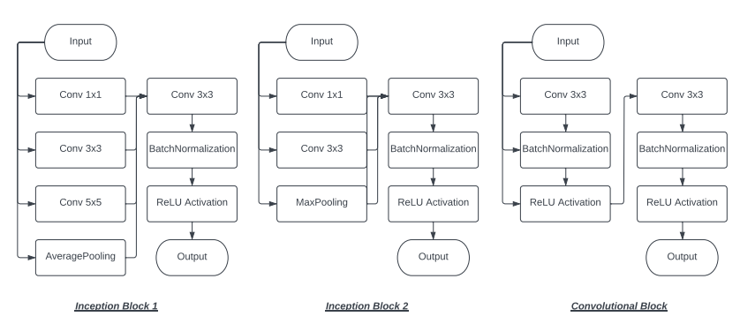
Encoder Design
Figure 4.3.1. Network design inspired by Inception Network
Civil and Environmental Engineering

Slide 20
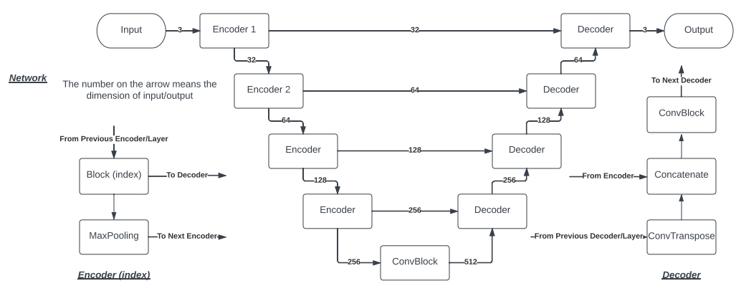
Encoder Design
Figure 4.3.2. Network design inspired by Inception Network
Civil and Environmental Engineering

Slide 21
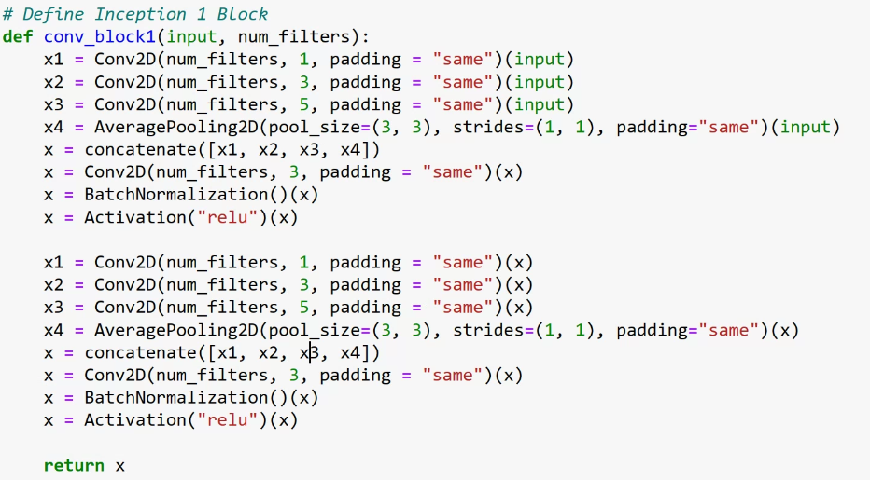
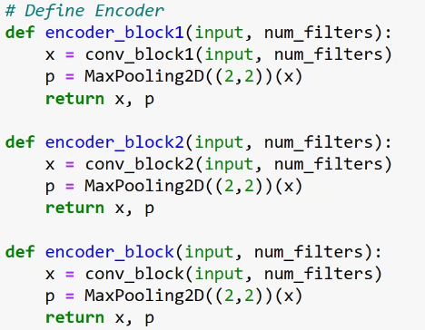
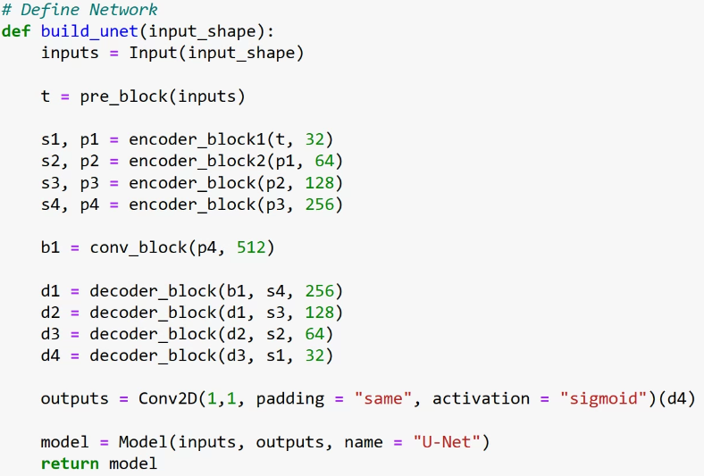
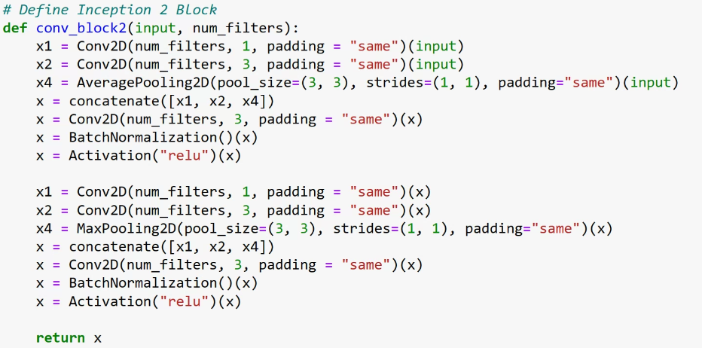
Implementation with Keras
Figure 4.4. Coding with TensorFlow.Keras
Civil and Environmental Engineering

Slide 22
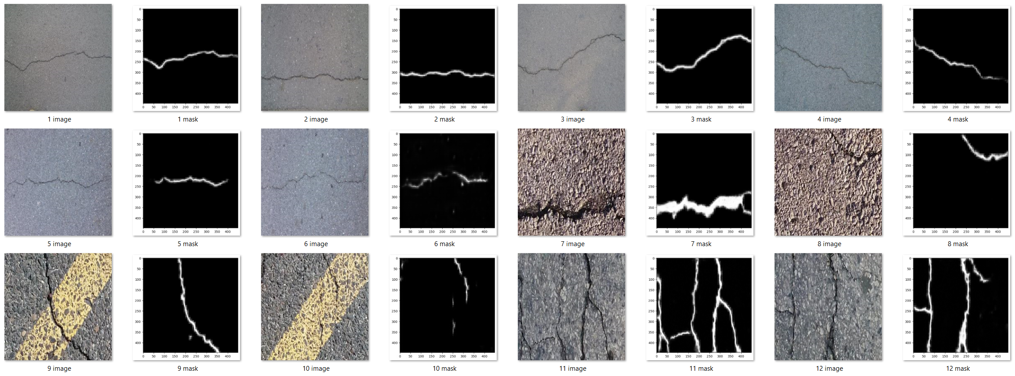
Result with CRACK500
Figure 4.5. Results with CRACK500 dataset
Civil and Environmental Engineering

Slide 23
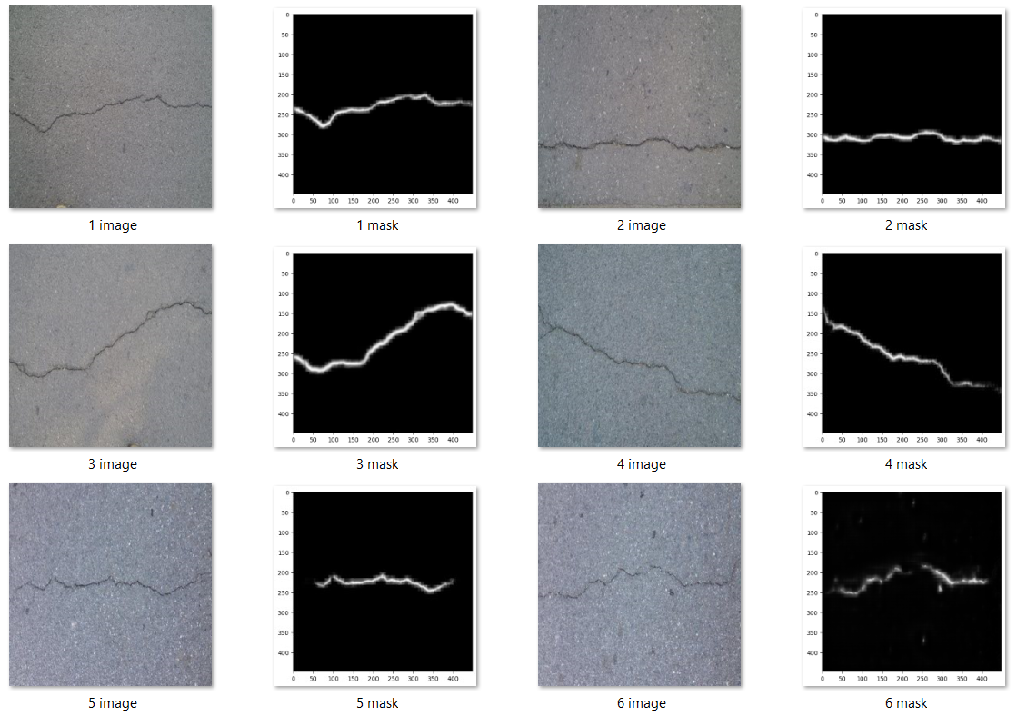
Comparison
Figure 4.6.1. Results with Initial U-Net architecture
Figure 4.6.2. Results with Inception U-Net
Civil and Environmental Engineering

Slide 24
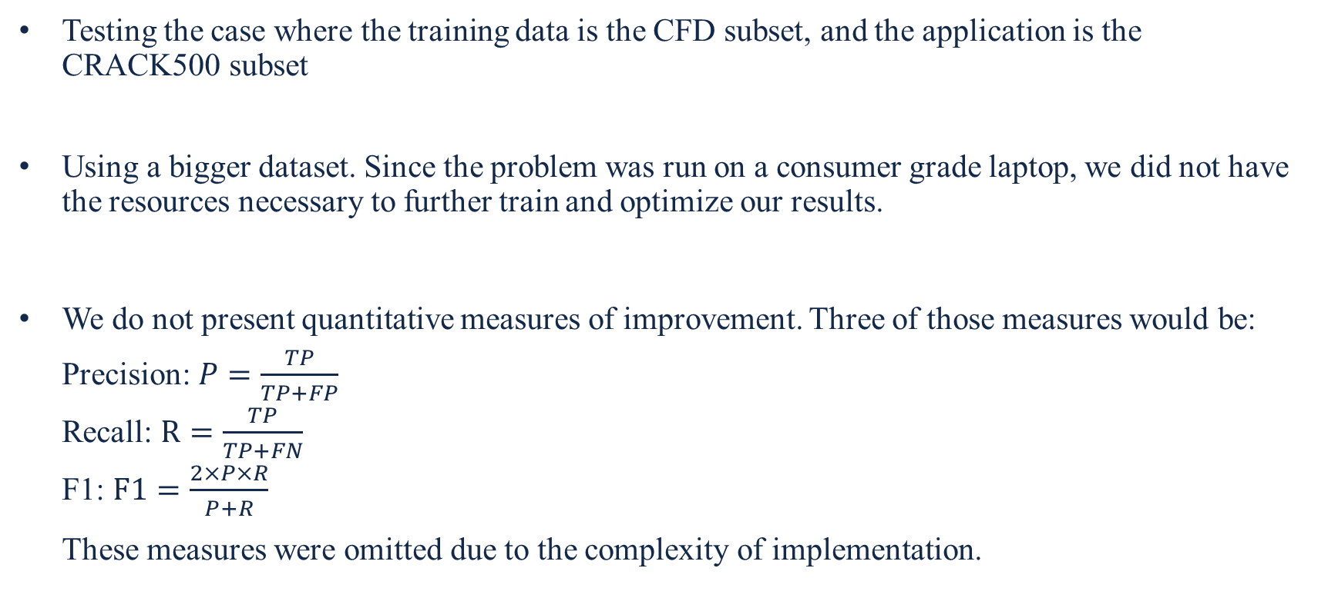
Potential additional improvement and future work
Testing the case where the training data is the CFD subset, and the application is the CRACK500 subset
Using a bigger dataset. Since the problem was run on a consumer grade laptop, we did not have the resources necessary to further train and optimize our results.
We do not present quantitative measures of improvement. Three of those measures would be: Precision: $P=\frac{TP}{TP+FP}$ Recall: $R=\frac{TP}{TP+FN}$ F1: $F1=\frac{2×P×R}{P+R}$ These measures were omitted due to the complexity of implementation.
Civil and Environmental Engineering

Slide 25
Statement of Individual Contribution
We both worked on all aspects of this project like literature review, coming up with ideas and potential architectures, organizing ideas, writing reports, etc.
Chengyou focused more on the implementation and testing of ideas
Sharbel focused more on the deliverables (progress report, presentation, etc.)
Civil and Environmental Engineering

Slide 26
References
O. Ronneberger, P. Fischer, T. Brox, U-net: Convolutional networks for biomedical image segmentation, International Conference on Medical Image Computing and Computer-assisted Intervention, 2015, https://doi.org/10.1007/978-3-319-24574-4_28 Munich, Germany
Eric Bianchi, Matthew Hebdon (2021) Concrete Crack Conglomerate Dataset https://doi.org/10.7294/16628596
Zhenqing Liu, Yiwen Cao, Yize Wang, Wei Wang, Computer vision-based concrete crack detection using U-net fully convolutional networks, Automation in Construction, 104 (2019) 129-139, https://doi.org/10.1016/j.autcon.2019.04.005
Christian Szegedy, Wei Liu, Yangqing Jia, Pierre Sermanet, Scott Reed, Dragomir Anguelov, Dumitru Erhan, Vincent Vanhoucke, Andrew Rabinovich, Going deeper with convolutions, IEEE Conference on Computer Vision and Pattern Recognition (CVPR), 2015, https://doi.org/10.48550/arXiv.1409.4842 Boston, USA
Cheng, D., & Lam, E. Y. (2021). Transfer learning U-Net deep learning for lung ultrasound segmentation. arXiv preprint arXiv:2110.02196.
Civil and Environmental Engineering

Slide 27
Thank You
Any Questions?
Civil and Environmental Engineering

